Slide 1
Cost-effective and sustainable Reduction of GHGs from ruminant production from Scotland
Eileen Wall and Jamie Newbold, SRUC
Stefan Hoyte, Scottish Govt

Slide 2
Greenhouse Emissions from Cattle Systems
Interacts with the system
Ruminants – ability to utilise lignocellulose and convert non-protein nitrogen into meat and milk
The cow
Processing,
retail,
waste

Slide 3

Marginal Abatement Costs
These are generally robust, well understood and “conservative” in scale

Slide 4
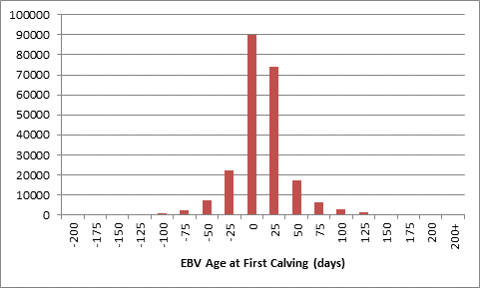
Beef genetics & GHG intensity
AFTER 5 YEARS OF SELECTION
Cumulative economic return of £47/cow calving (+20%)
Cumulative GHG reduction 95 kgCO₂e/cow calving (-18%)
Age1stCalf = 31.2 months
  Breed range: 30.1-33.7
h² age @ 1st calf = 39%
64.5 days difference between top & bottom quartiles
64.5 days
Notes:
Maternal traits are more readily available as we used BES records plus historic BCMS data for BES farms.
These traits were also under genetic control, with higher estimated heritability (the proportion of variation in the population that is under genetic control) than some of the terminal traits where we have less data available.
There was over 2 months difference between the top and bottom quartiles for genetic merit for age at first calving demonstrating a huge potential to alter via breeding decisions.

Slide 5
Value of “Breeding” – after 10 years+
 | Available | Estimated cumulative £ | Estimated cumulative GHGs
BREEDING
Improving prodn | NOW | ↑10-22% profit | ↓5-10% in CO₂eq
Improving female fertility | NOW | ↑20-35% profit | ↓10-18% in CO₂eq
Improving feed efficiency | SOON | ↑23-43% profit | ↓14-26% in CO₂eq
Genomic selection | NOW(ish) | ↑40-75% profit | ↓35-73% in CO₂eq
Sexed Semen | Now | ~↑50-80% profit | ~↓38-76% in CO₂eq
Precision breeding | Under dev | ~↑50-100% profit | ~↓50-100% in CO₂eq
Notes:
Genetic databases such as BES can have lots of added value through using data to maximum potential for real time management but also in terms of integrating with other innovations

Slide 6
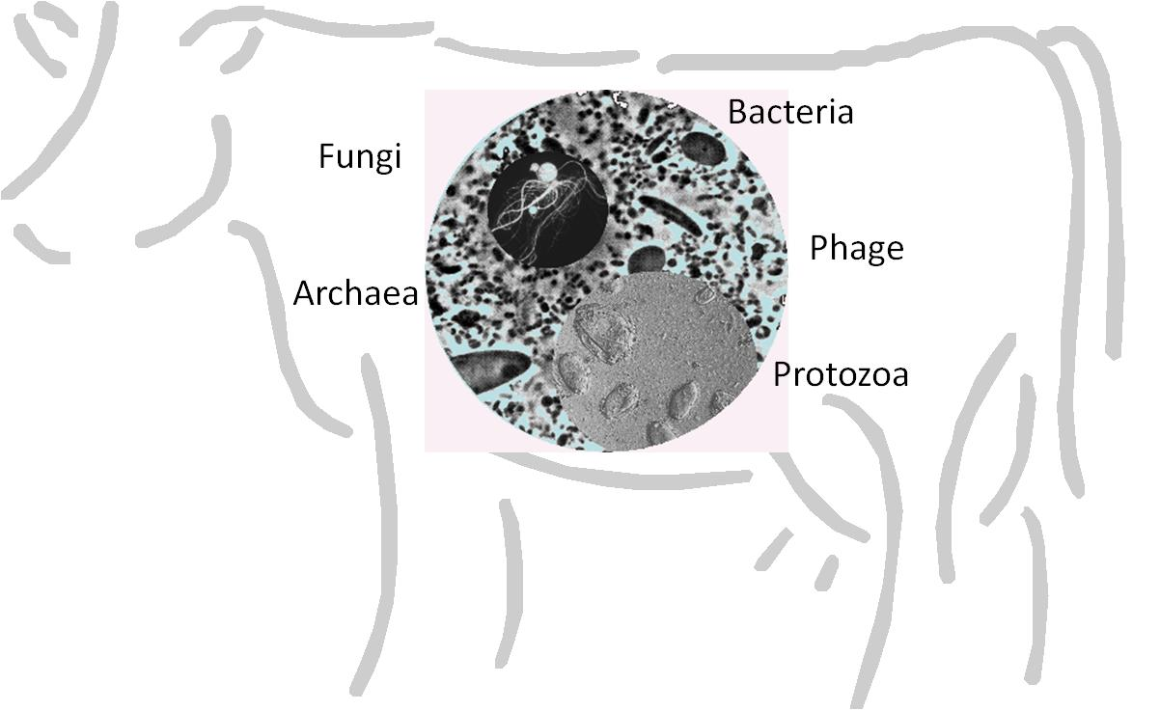
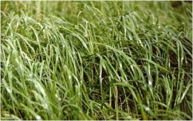
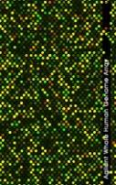


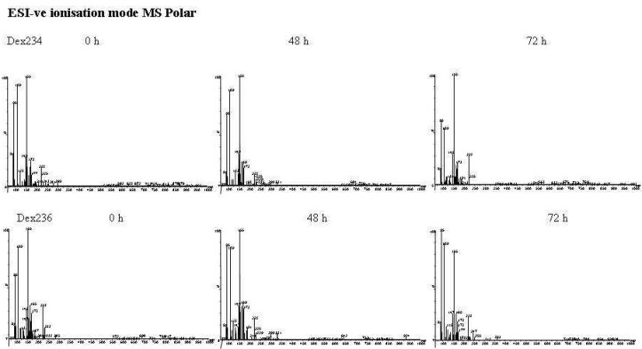
Biological systems approach
Improved feed
Low emissions
Improved productivity
Primary feeds
Integrated analysis
Trait selection
Transcriptome
(Meta)genome
Proteome
Metabolome

Slide 7
Value of “Feeding” – after 10 years+
 | Available | Est. cumulative profit £ | Est. cumulative GHGs in CO₂eq
BREEDING
Improving prodn | NOW | ↑10-22% | ↓5-10%
Improving female fertility | NOW | ↑20-35% | ↓10-18%
Improving feed efficiency | SOON | ↑23-43% | ↓14-26%
Genomic selection | NOW(ish) | ↑40-75% | ↓35-73%
Sexed Semen | NOW | ~↑50-80% | ~↓38-76%
Precision breeding | Under dev | ~↑50-100% | ~↓50-100%
FEEDING – IN ADDITION
Rumen bug info | Under dev | +0-10% | -10-25%
Feed additives | NOW | +0-10% | -15-30%
Plant additives | NOW(ish) | +0-6% | -10-17%
Precision breeding feed | Under dev | ~ | -15-100%
Notes:
Genetic databases such as BES can have lots of added value through using data to maximum potential for real time management but also in terms of integrating with other innovations

Slide 8
Value of “Breeding” & “Feeding” – MACC
 | Available | Est. cumulative profit £ | Est. cumulative GHGs in CO₂eq
BREEDING
Improving prodn | NOW | ↑10-22% | ↓5-10%
Improving female fertility | NOW | ↑20-35% | ↓10-18%
Improving feed efficiency | SOON | ↑23-43% | ↓14-26%
Genomic selection | NOW(ish) | ↑40-75% | ↓35-73%
Sexed Semen | NOW | ~↑50-80% | ~↓38-76%
Precision breeding | Under dev | ~↑50-100% | ~↓50-100%
FEEDING – IN ADDITION
Rumen bug info | Under dev | +0-10% | -10-25%
Feed additives | NOW | +0-10% | -15-30%
Plant additives | NOW(ish) | +0-6% | -10-17%
Precision breeding feed | Under dev | ~ | -15-100%
Notes:
While some of these are represented in the MACC numbers many are low estimates, do not reflect to full technical potential and/or application to broader population (uptake).

Slide 9
“Breeding” & “Feeding” – Needs
 | Available | profit £ | GHGs in CO₂eq | Needs
BREEDING
Improving prodn | NOW | ↑10-22% | ↓5-10% | Uptake, tools
Improving female fertility | NOW | ↑20-35% | ↓10-18% | Uptake, tools
Improving feed efficiency | SOON | ↑23-43% | ↓14-26% | Delivery+
Genomic selection | NOW(ish) | ↑40-75% | ↓35-73% | Delivery+
Sexed Semen | NOW | ~↑50-80% | ~↓38-76% | Uptake, tools
Precision breeding | Under dev | ~↑50-100% | ~↓50-100% | Research
FEEDING – IN ADDITION
Rumen bug info | Under dev | +0-10% | -10-25% | Res & Delivery
Feed additives | NOW | +0-10% | -15-30% | Uptake, tools
Plant additives | NOW(ish) | +0-6% | -10-17% | Research
Precision breeding feed | Under dev | ~ | -15-100% | Research
Notes:
While some of these are represented in the MACC numbers many are low estimates, do not reflect to full technical potential and/or application to broader population (uptake).
And we need to realise the needs on research and development but also policy and practice

Slide 10

The need to breed and feed for net zero
Many tools available
  Research on context and situational valuation
  Support for practice improvement
Some R&D required on some
  Testing tool(s) in Scottish context
  More product development
  Policy levers to achieve adoption
Added/New R&D
  Integration with non-animal interventions
  Technology development & delivery
  Policy, food chain testing

Slide 11



Thank you
sefari.scot
info@sefari.scot
@SEFARIscot

