Slide 1
BVD case study
Dr George Russell, Moredun Research Institute
Pr Andrew Barnes, SRUC
Nathan Liddle, BVD Policy Team, Animal Health & Welfare Division

Slide 2
BVD introduction
Viral infection of cattle with significant economic consequences
Worldwide problem; many countries have eradication programmes
Virus spread by persistently infected cattle, infected in utero
Increases susceptibility to other diseases, infertility, abortion
Scottish BVD eradication industry-led with SG support
Started 2012, now in phase 5
Samples from approved laboratories collected by MRI for typing
Notes:
Bovine viral diarrhoea virus is a worldwide problem that affects cattle. Infection, particularly of young cattle, suppresses the immune system and makes animals prone to other infections. Control is possible by vaccination but this makes it difficult to distinguish vaccinated from infected cattle. Infection of pregnant cattle can cause infertility, abortion and birth of persistently infected calves that are tolerant of the BVD infection and which shed BVDV throughout their lives, making PI cattle the main source of infection for herds and removal of PI animals is the main target for eradication campaigns.
The Scottish BVD eradication is an industry led campaign that started in 2012 and is now in phase five, having substantially reduced the numbers of infected herds and of PI cattle.
Approved laboratories, such as those of SRUC veterinary services, provide testing services that can identify PI cattle and serum samples from positive tests have been collected by Moredun Research Institute for more detailed strain typing by sequencing

Slide 3
BVD economic assessment
Established a risk analysis-based framework for BVD combining the epidemiology with the economics of various interventions
Subsequently underpinned the rationale for cost-effective control strategies that have been adopted in health schemes around the UK.
The farm-level savings to the industry from future eradication are estimated to be £50-£80m.
Notes:
We have been exploring the economic consequences of BVD for a number of decades and established a multidisciplinary framework that allows assessment of BVD (and other diseases) used in establishing costs and more importantly the impact of interventions
Cost-effective control strategies include assessing the impact of BVD eradication policy on Scottish farms.
Given that the costs accumulate as infection increases (figure) – then we can look at the savings from removal of Pis from the Herd and more mandatory control approaches.
We used these economic tools to support arguments for eradication schemes and we found a saving from a future eradication scheme to be around 50 – 80 million in private cost savings
. Note on GHGs???

Slide 4
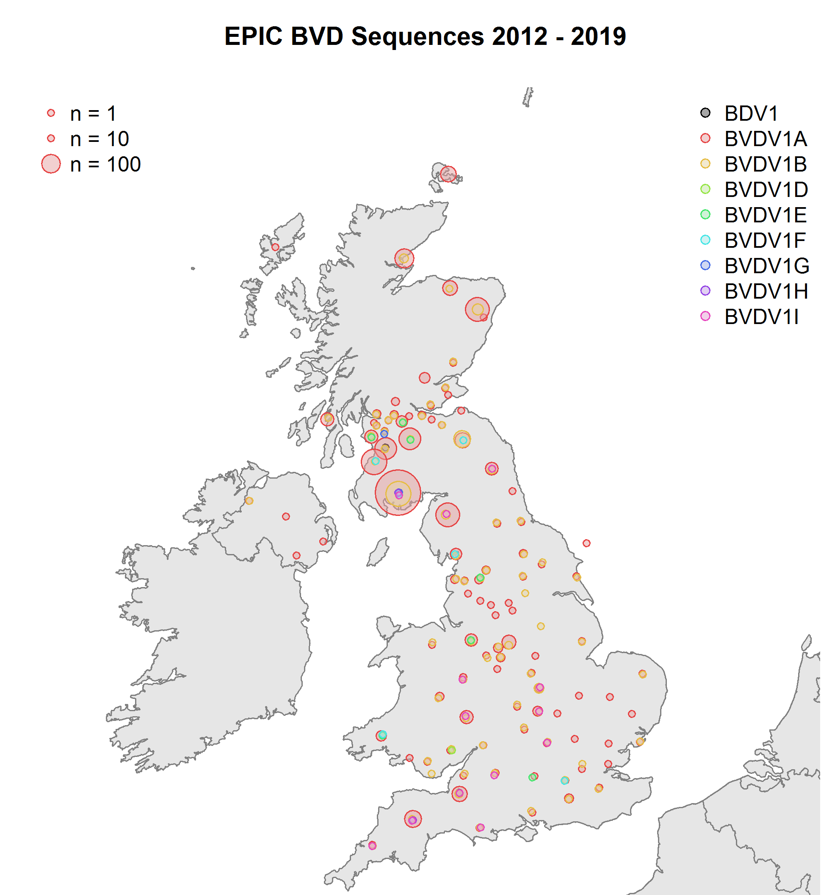
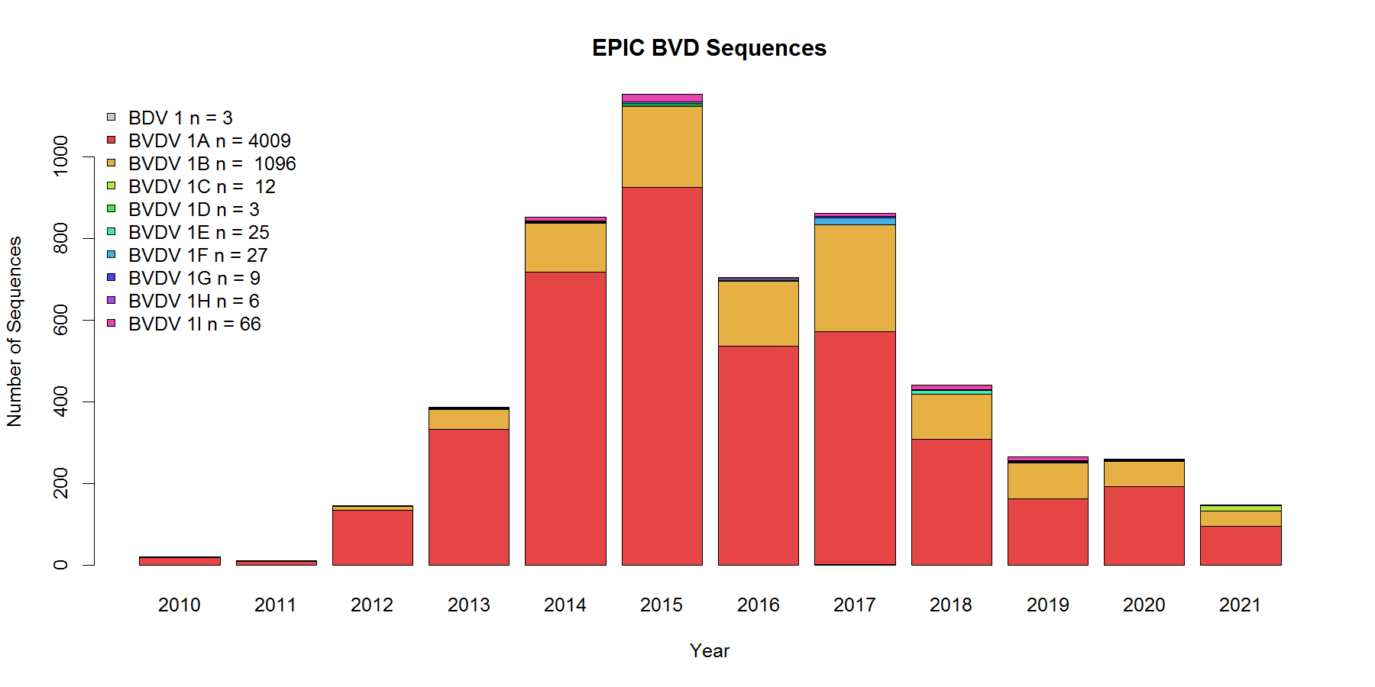
BVD sequences
> 6000 serum samples → 5256 UTR sequences
Nine genotypes in full dataset
(1a,1b,1c,1d,1e,1f,1g,1h,1i).
Have Animal IDs & Post-codes for ~70%
Notes:
Since 2012, Moredun has assembled a Biobank of over 6000 BVD-positive serum samples, and has typed over 5000 samples by partial sequencing
Nine subtypes of BVDV 1 have been found in samples from all parts of the UK, and associated data, such as UK number and submitting location can be used to track the movement of infected animals and the BVD strains they carry.
The graph shows that BVDV1a and 1b make up over 90% of samples tested and illustrates the progress of eradication in terms of numbers of positive samples analysed.
The map shows the locations from which samples were obtained, showing that most of the samples analysed came from cattle-dense regions of Scotland, and also that the BVDV types seen in Scotland reflect what is found across the UK .
These data provide a resource for additional analyses performed as part of the EPIC Centre of Expertise, such as the showing that the number of virus variants has reduced as the eradication has progressed

Slide 5
Scottish Government policy impacts
Strategic oversight of genetic variation across Scotland
Allows Scotland (as part of GB) to comply with the EU Animal Health Regulation requirement for Third Countries to report BVD2
Discriminates between BVD and other Pestiviruses, helps to allay the concern that BVD positive cattle might be infected with Border Disease (occurs, but very rarely)
Potential to link cases and identify the source of infection. Possible future application: investigating disease incursions after BVD eradication.

Slide 6
Thank you
sefari.scot
info@sefari.scot
@SEFARIscot

